Slide 1




Predicting Video Game User Ratings
Josh Gardner
DSC 680 Applied Data Science

Slide 2
Problem Statement
Video Game sales generate billions in sales each year, but not every game receives a user rating.
Dobrilova, T. (4 Apr. 2019) *Techjury.* "How much is the gaming industry worth?" Retrieved 26 Oct. 2019 from https://techjury.net/stats-about/gaming-industry-worth

Slide 3
Research Questions
Do ratings influence the number of games bought?
Do critic ratings influence user ratings?
Can machine learning predict what the user ratings should be?

Slide 4
Where Data was Gathered From
The data for this project is gathered from the publicly available datasets from Kaggle.

Slide 5
Analysis Plan
Explore the data
1
Explore how the different variables relate to each other
2
Create three different models to predict the user rating:
3
Logistic Regression Model
Decision Tree Model
Random Forest Model

Slide 6
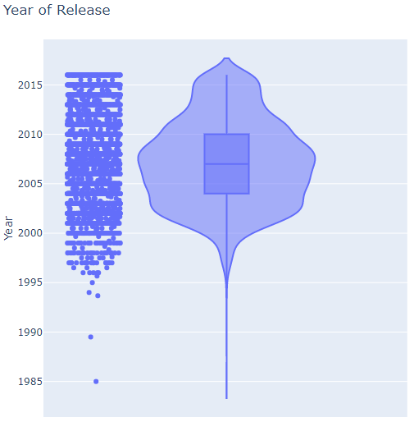
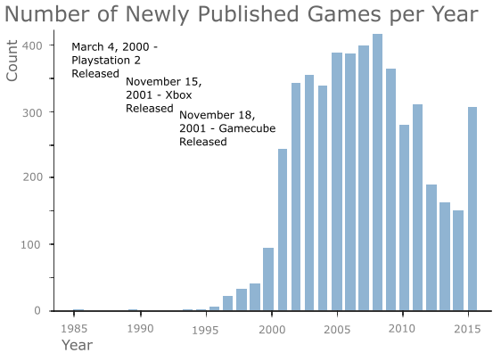
Year of Release
The highest number of new games were published in 2008.
There is a large increase in the number of new games after the PlayStation 2, Xbox, and GameCube were released.

Slide 7
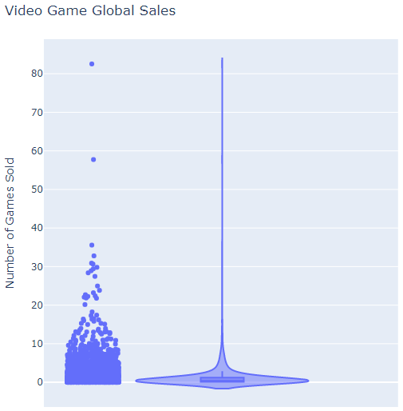
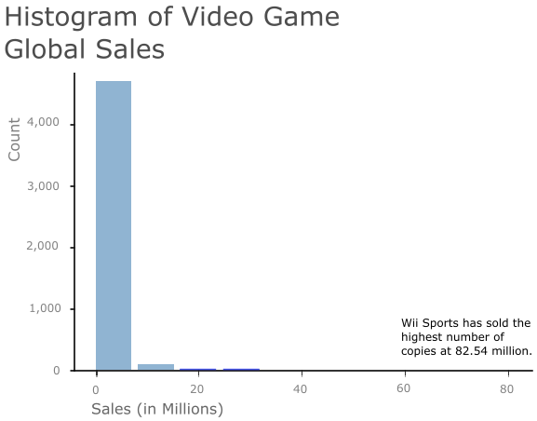
Sales
Most games do not sell over a million copies.
However, games that sell over a million copies often sell large quantities of copies.

Slide 8
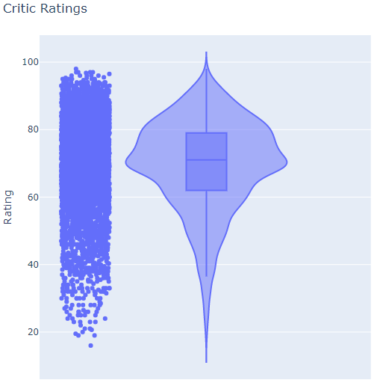
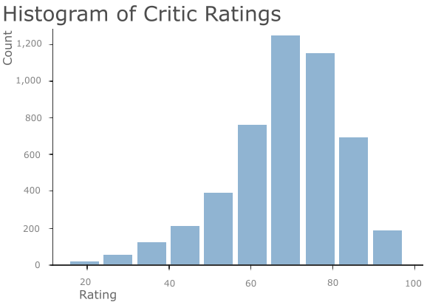
Critic Ratings
Most games are given a Critic Rating around 70.
The distribution of scores is normal.

Slide 9
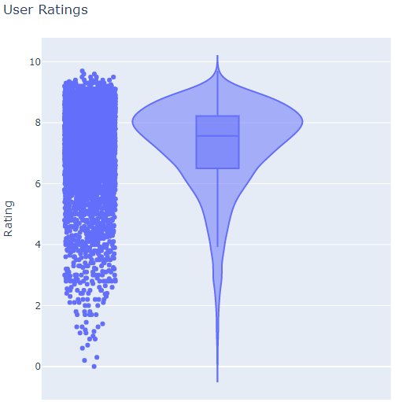
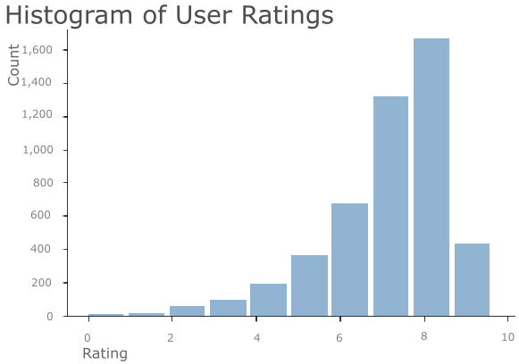
User Ratings
Most User Ratings are around 8. When compared to Critic Scores, this is equivalent to a Critic Rating of 80.
The distribution of User Ratings is normal.

Slide 10
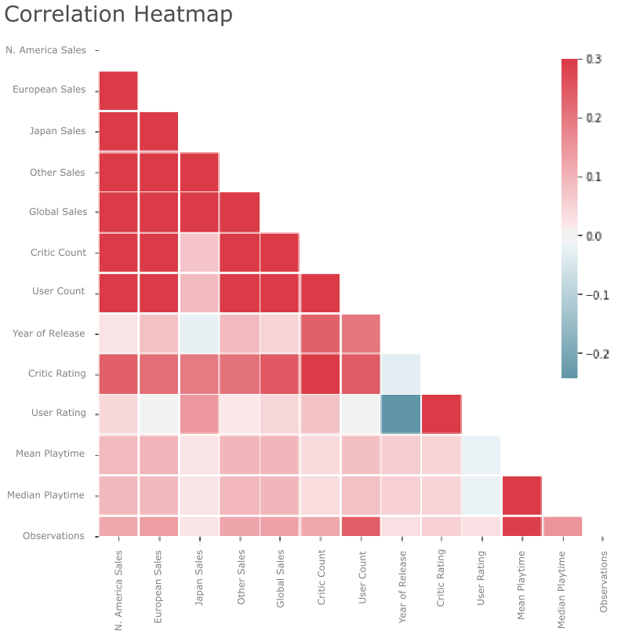
Correlations
The strongest correlation is between the critic ratings and user ratings. This is a moderately strong, positive correlation.
The year of release and the user ratings have a moderate negative correlation.

Slide 11
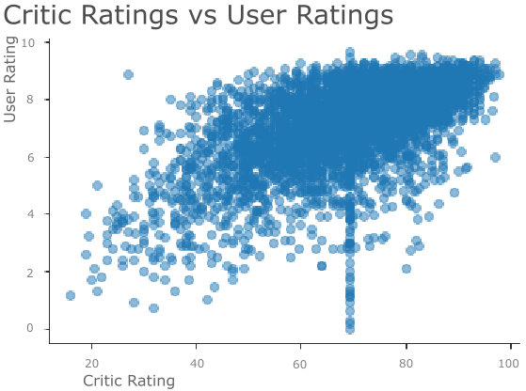
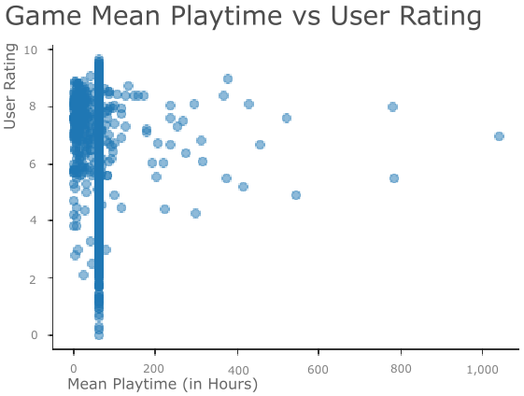
Scatter Plots
Critic Ratings and User Ratings do not align perfectly.
Most games are not played for very long before they are rated by the users.

Slide 12
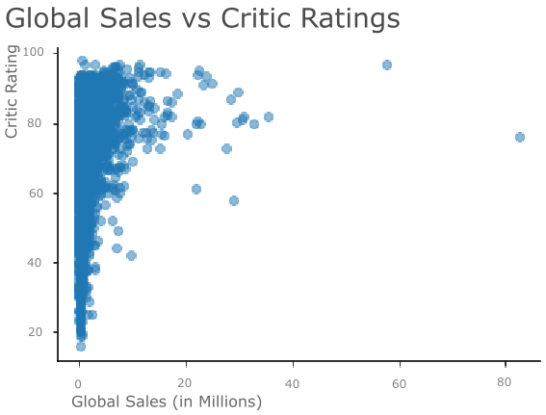
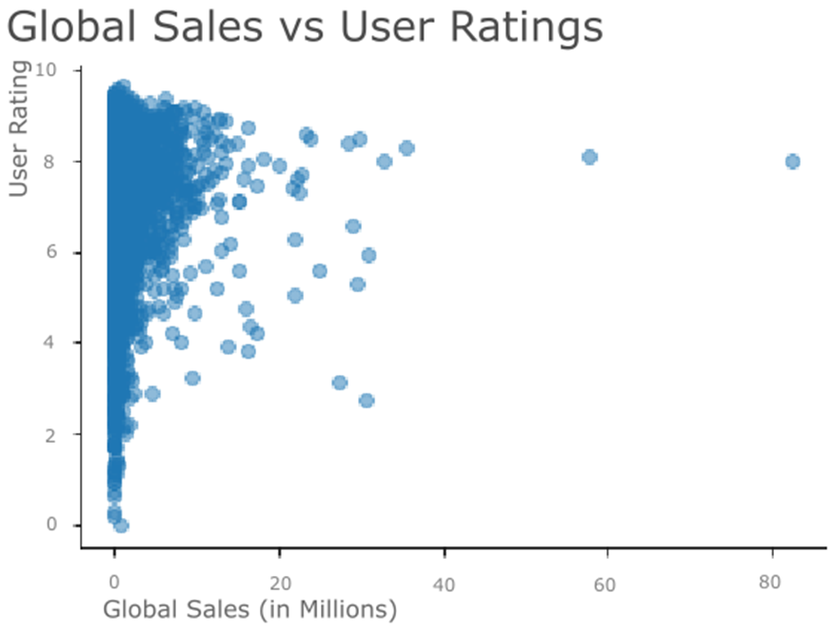
Scatter Plots
User Ratings are much more spread out than the Critic Ratings when both are compared to the number of Global Sales.

Slide 13
Predicting User Scores
We generated 3 different models to predict the user score
Logistic Regression
Decision Tree
Random Forest

Slide 14
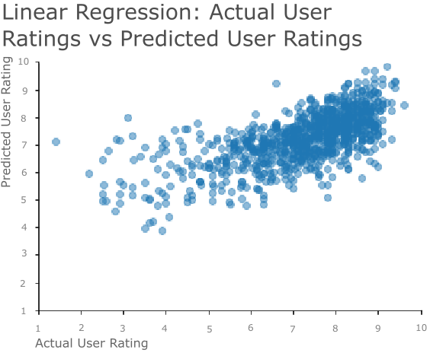
Logistic Regression Model
Root Mean Square Error: 1.052
Percent of Mean Error: 14.562%

Slide 15
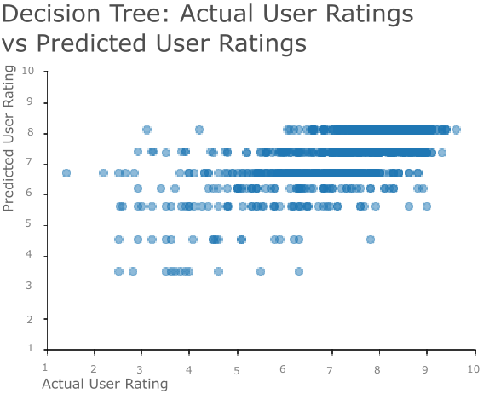
Decision Tree
Root Mean Square Error: 1.092
Percent of Mean Error: 15.115%

Slide 16
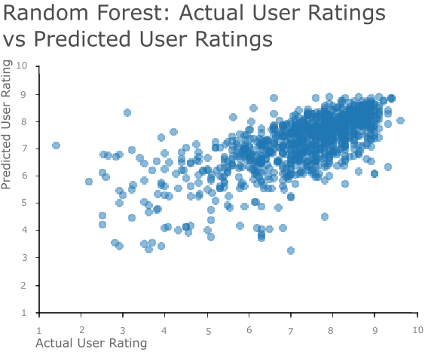
Random Forest
Root Mean Square Error: 1.034
Percent of Mean Error: 14.313%

Slide 17
Revisiting Research Questions
1. Do ratings influence the number of games bought?
Yes, a game’s ratings do influence the number of game copies that are bought. Critic ratings influence the number of games bought more than user ratings.
There is a moderate, positive correlation between the critic ratings and the number of game copies sold. This relationship is statistically significant.
There is a very weak, positive correlation between the user ratings and the number of game copies sold. This relationship is statistically significant.

Slide 18
Revisiting Research Questions
2. Do critic ratings influence user ratings?
Yes, critic ratings and the user ratings show a moderately strong, positive relationship. As one increases, the other tends to increase as well.
This relationship is statistically significant.

Slide 19
Revisiting Research Questions
3. Can machine learning predict what the user ratings should be?
Machine learning can be used to predict what the user ratings for a game should be.
Our models are not the most accurate but do give a decent prediction of the user rating.

Slide 20
Potential Use Case of Models
To give a user rating to games created before user ratings were tracked

Slide 21
Summary
A game’s ratings do influence the number of game copies sold.
Critic ratings and user ratings are positively correlated.
Machine learning can be used to predict user ratings.

Slide 22
Sources
1. Dobrilova, T. (4 Apr. 2019) *Techjury.* "How much is the gaming industry worth?" Retrieved 26 Oct. 2019 from https://techjury.net/stats-about/gaming-industry-worth
2. Tamber. Kaggle. “Steam Video Games.” Retrieved 22 Oct 2019 from https://www.kaggle.com/tamber/steam-video-games
3. Rakesh, J. Kaggle. “Video Game DATA.” Retrieved 22 Oct 2019 form https://www.kaggle.com/juttugarakesh/video-game-data
4. Tristan. Kaggle. “17k Mobile Strategy Games.” Retrieved 22 Oct 2019 from https://www.kaggle.com/tristan581/17k-apple-app-store-strategy-games
5. Smith, G. Kaggle. “Video Game Sales.” Retrieved 22 Oct 2019 from https://www.kaggle.com/gregorut/videogamesales
6. Kirubi, R. Kaggle. “Video Game Sales with Ratings.” Retrieved 22 Oct 2019 from https://www.kaggle.com/rush4ratio/video-game-sales-with-ratings
7. SIC_TWR. Kaggle. “Video Games Sales Dataset.” Retrieved 22 Oct 2019 from https://www.kaggle.com/sidtwr/videogames-sales-dataset
8. Alqunber, A. Kaggle. “Video Games Sales 2019.” Retrieved 22 Oct 2019 from https://www.kaggle.com/ashaheedq/video-games-sales-2019
9. Gillies, K. Kaggle. “Video Game Sales and Ratings.” Retrieved 22 Oct 2019 from https://www.kaggle.com/kendallgillies/video-game-sales-and-ratings
10. Christian, L. Kaggle. “Video Games Review.” Retrieved 22 Oct 2019 from https://www.kaggle.com/launay10christian/video-games-review
11. Alex. Kaggle. “Video games with reviews and playtime statistics.” Retrieved 25 Oct 2019 from https://www.kaggle.com/alex333/video-games-with-reviews-and-playtime-statistics
12. Wikipedia. “Playstaion 2.” Retrieved 9 Nov. 2019 from https://en.wikipedia.org/wiki/PlayStation_2
13. Wikipedia. “Xbox.” Retrieved 9 Nov. 2019 from https://en.wikipedia.org/wiki/Xbox
14. Simple English Wikipedia. “Nintendo GameCube.” Retrieved 9 Nov. 2019 from https://simple.wikipedia.org/wiki/Nintendo_GameCube

